Slide 1
Image Enhancement-II
Lecture-4 (26th August 2021)

Slide 2
Last lecture
Image enhancement techniques
Spatial domain
Image negative
Log transformation
Gamma transformation
Contrast stretching
Intensity level slicing
Histogram processing
Histogram equalization
Histogram specification/matching/modification

Slide 3
Image enhancement techniques
Objective – process an image so that the result is more suitable than the original image for a specific application. (improve the quality)
Methods:
Spatial Domain direct manipulation of pixels of the image
Frequency Domain modifying the frequency transformed image

Slide 4
1. Image Negative
Let the image has an intensity level in the range [0 L-1], then the intensity transformation is given by s=L-1-r
s=T(r)
L-1
L=intensity levels
Output intensity
0
L-1
r
Input intensity

Slide 5
2. Log Transformation
For an image having intensity ranging from [0 L-1], log transformation is given by s=c log(1+r) , where c is a constant.
s=T(r)
Maps the narrow range of low intensity values of input levels to wider range of output levels.
Higher range of high intensity input levels is mapped to narrow range of out put levels.
L-1
Output intensity
0
L-1
r
Input intensity

Slide 6
3. Power-law (Gamma) Transformation
This has the basic form s=c r^{γ} ,where c and γ are positive constants
Dark input → bright output when gamma<1
Same input and output at gamma=1
bright input → dark output when gamma >1
Plot for c=1

Slide 7
4. Contrast stretching
s = T(r)
Sometimes, image viewed in the screen is very dark (poor contrast).
Poor illumination
dynamic range of the sensor is very small. (capacity to record min and max intensity value)
aperture of lens is not properly set.
L-1
(r₂,s₂)
3L/4
L/2
T(r)
output intensity level, s
L/4
0
(r₁,s₁)
Expand a range of intensities at input to desired range at output.
0
L/4
L/2
3L/4
L-1
Input intensity level, r

Slide 8
5. Intensity Level slicing
Highlighting specific range of intensities.
Example :
Enhancing features such as masses of water in the satellite imagery
Enhancing flaws in X-ray images.
Contrast stretching: whole image intensity is affected

Slide 9
L-1
L-1
T(r)
s
r
0
L-1

Slide 10
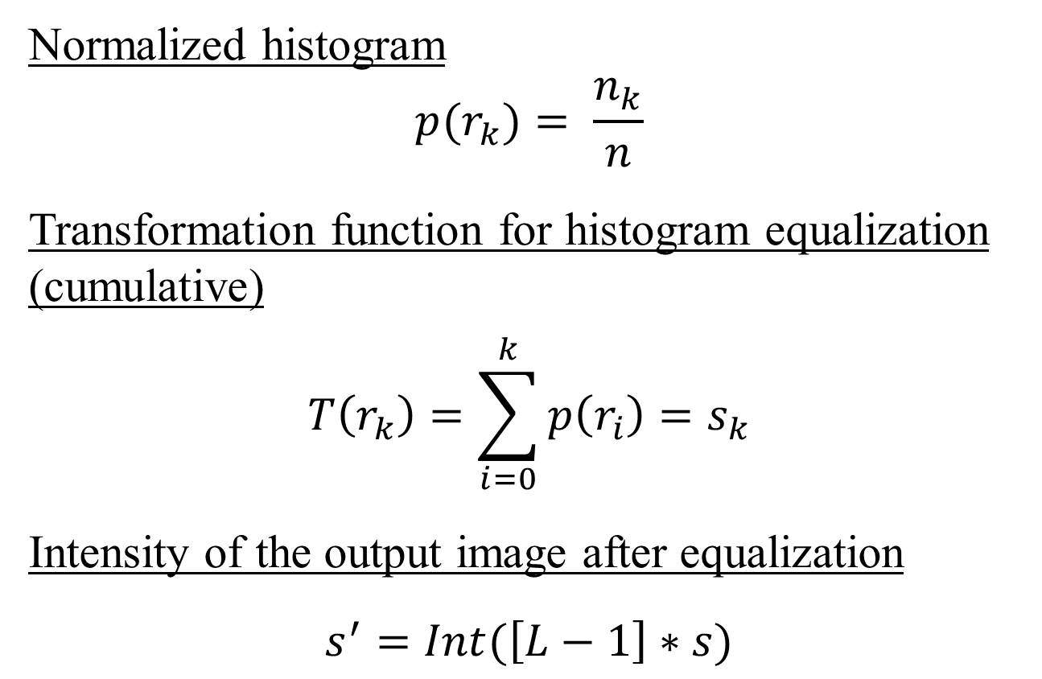
Histogram equalization
Normalized histogram
$${p(r}_{k})= \frac{n_{k}}{n}$$
Transformation function for histogram equalization
(cumulative)
$$T\left(r_{k}\right)=\sum_{i=0}^{k}{p\left(r_{i}\right)}=s_{k}$$
Intensity of the output image after equalization
$$s^{′}=Int(\left[L−1\right]∗s)$$

Slide 11
R (input intensity values) | P(r) (normalized histogram) | PDF | T(r) = s CDF | s’ (output intensity values)
0 | 2 | 0.05 | 0.05 | 0
1 | 2 | 0.05 | 0.1 | 0
2 | 0 | 0 | 0.1 | 0
3 | 0 | 0 | 0.1 | 0
4 | 0 | 0 | 0.1 | 0
5 | 6 | 0.15 | 0.25 | 1
6 | 14 | 0.35 | 0.60 | 4
7 | 16 | 0.40 | 1 | 7
 | Sum=40

Slide 12

Histogram matching
Input histogram
$${p_{r}(r}_{k})= \frac{n_{k}}{n}$$
Target histogram ${p_{z}(z}_{k})$
$$T\left(r_{k}\right)=\sum_{i=0}^{k}{p_{r}\left(r_{i}\right)}=s_{k}$$
$$v_{k}=G\left(z_{k}\right)=\sum_{i=0}^{k}{p_{z}\left(z_{i}\right)}=s_{k}$$
Transformation matrices
$$z_{k}=\min{value of z for which G\left(z\right)−s≥0}$$

Slide 13
R (input intensity values) | Pr(r) (histogram) | T(r) = s | Pz(z) | G(z) | Z’ (output intensity)
0
1
2
3
4
5
6
7

Slide 14
R (input intensity values) | Pr(r) (histogram) | T(r) = s | Z | Pz(z) | G(z) | Z’ (output intensity)
0 | 0 | 0 | 0 | 0 | 0 | 0
1 | 0.1 | 0.1 | 1 | 0.1 | 0.1 | 1
2 | 0.1 | 0.2 | 2 | 0.2 | 0.3 | 2
3 | 0.3 | 0.5 | 3 | 0.4 | 0.7
4 | 0 | 0.5 | 4 | 0.2 | 0.9
5 | 0 | 0.5 | 5 | 0.1 | 1
6 | 0.4 | 0.9 | 6 | 0 | 1
7 | 0.1 | 1 | 7 | 0 | 1

Slide 15
R (input intensity values) | Pr(r) (histogram) | T(r) = s | Z | Pz(z) | G(z) | Z’ (output intensity)
0 | 0 | 0 | 0 | 0 | 0 | 0
1 | 0.1 | 0.1 | 1 | 0.1 | 0.1 | 1
2 | 0.1 | 0.2 | 2 | 0.2 | 0.3 | 2
3 | 0.3 | 0.5 | 3 | 0.4 | 0.7 | 3
4 | 0 | 0.5 | 4 | 0.2 | 0.9 | 3
5 | 0 | 0.5 | 5 | 0.1 | 1 | 3
6 | 0.4 | 0.9 | 6 | 0 | 1 | 4
7 | 0.1 | 1 | 7 | 0 | 1 | 5

Slide 16
Q1. A color Image have
2 value per pixel
3 value per pixel
4 value per pixel
1 value per pixel
Ans: b
Q2. What is the storage requirement of 1024 X 1024, 8 level gray level image?
Ans: 1024 x 1024 x 8

Slide 17
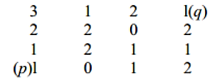
Q3. Consider image segment shown here:
Let V = {0, 1}. Compute the lengths of shortest 4, 8 and m-path between (p) and (q).

Slide 18
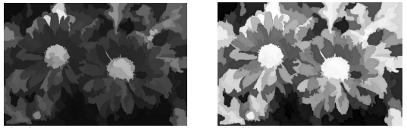
Q4. In order to obtain the image in Fig. 1.b from the original image in Fig. 1.a, which point processing operation should be applied:
contrast stretching
Image negative
histogram equalization
Gamma transformation with gamma=3
Fig. 1.a
Fig. 1.b

Slide 19
Q4. In order to obtain the image in Fig. 1.b from the original image in Fig. 1.a, which point processing operation should be applied:
contrast stretching
Image negative
histogram equalization
Gamma transformation with gamma=3
Ans: a, c
Fig. 1.a
Fig. 1.b

Slide 20
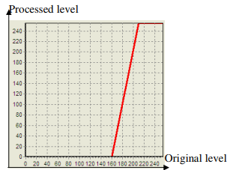
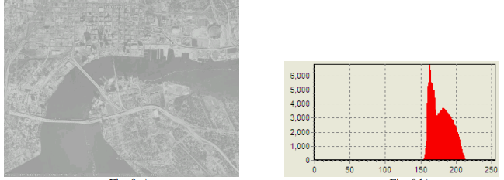
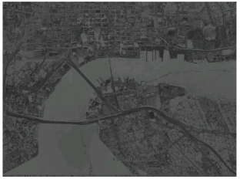
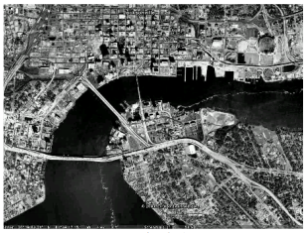
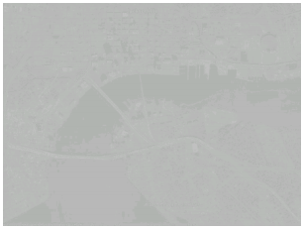
Q5. The image in Fig. 2.a represents an original image of low contrast, having a histogram given in Fig. 2.b. If on this image, a spatial domain processing is applied, using the transfer function - Fig. 2.c, which of the following will be the resulting image?
the same as the original
the image in Fig. 2.d
the image in Fig. 2.e
the image in Fig. 2.f
Fig. 2.c
Fig. 2.a
Fig. 2.b
Fig. 2.d
Fig. 2.e
Fig. 2.f

Slide 21
Q5. The image in Fig. 2.a represents an original image of low contrast, having a histogram given in Fig. 2.b. If on this image, a spatial domain processing is applied, using the transfer function - Fig. 2.c, which of the following will be the resulting image?
the same as the original
the image in Fig. 2.d
the image in Fig. 2.e
the image in Fig. 2.f
Fig. 2.c
Ans: c
Fig. 2.a
Fig. 2.b
Fig. 2.d
Fig. 2.e
Fig. 2.f

Slide 22
What is an image histogram?
Give the transformation function of histogram equalization technique.
Suppose a digital image is subjected to histogram equalization. What effect will a second pass equalization have over the equalized image?
What is histogram matching technique? What are the steps to carry out this technique?

Slide 23
Today’s lecture
Mask processing techniques
Linear smoothing filter (averaging)
Median filter (nonlinear)
Sharpening filter

Slide 24
The Spatial Filtering Process
Origin
x
a
b
c
j
k
l
d
e
f
*
m
n
o
g
h
i
p
q
r
Original Image Pixels
Filter (w)
Simple 3*3 Neighbourhood
e
3*3 Filter
e_{processed} = n*e + j*a + k*b + l*c
+ m*d + o*f + p*g
+ q*h + r*i
y
Image f (x, y)

Slide 26

Smoothing Spatial Filters
1. Simple averaging filter
Simply average all of the pixels in a neighbourhood around a central value.
Useful in removing noise from images.
1 | 1 | 1
1 | 1 | 1
1 | 1 | 1
¹/₉
¹/₉
¹/₉
$$\frac{1}{9}×$$
¹/₉
¹/₉
¹/₉
¹/₉
¹/₉
¹/₉

Slide 27
104
100
108
¹/₉
¹/₉
¹/₉
99
106
98
*
¹/₉
¹/₉
¹/₉
95
90
85
¹/₉
¹/₉
¹/₉
Original Image Pixels
Filter
e = ¹/₉*106 + ¹/₉*104 + ¹/₉*100 + ¹/₉*108 + ¹/₉*99 + ¹/₉*98 + ¹/₉*95 + ¹/₉*90 + ¹/₉*85
= 98.3333

Slide 28
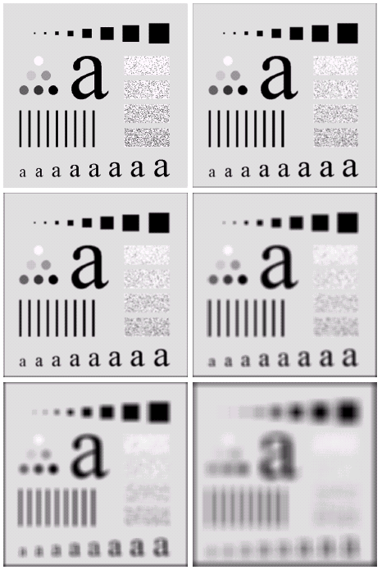
Image Smoothing Example
The image at the top left is an original image of size 500*500 pixels.
The subsequent images show the image after filtering with an averaging filter of increasing sizes
→ 3, 5, 9, 15 and 35

Slide 29
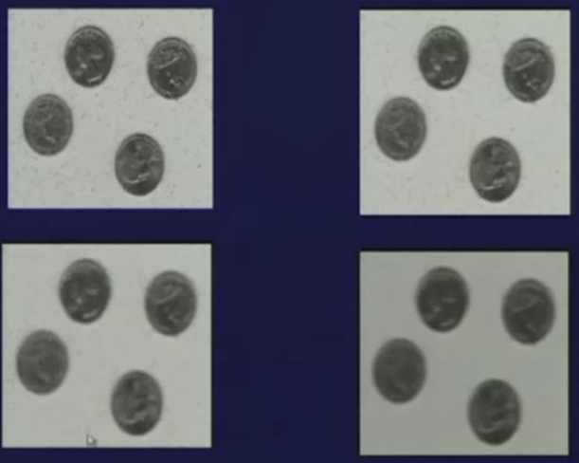

Slide 30
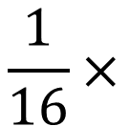
2. Weighted averaging filter
Averaging filter disadvantage:
Noise is removed but has high blurring effect.
To avoid high blurring effect in simple averaging filter
1 | 2 | 1
2 | 4 | 2
1 | 2 | 1
¹/₁₆ | ²/₁₆ | ¹/₁₆
²/₁₆ | ⁴/₁₆ | ²/₁₆
¹/₁₆ | ²/₁₆ | ¹/₁₆
$$\frac{1}{16}×$$

Slide 31
In case of weighted averaging filter, the blurring effect reduces compared to the averaging filter.

Slide 32
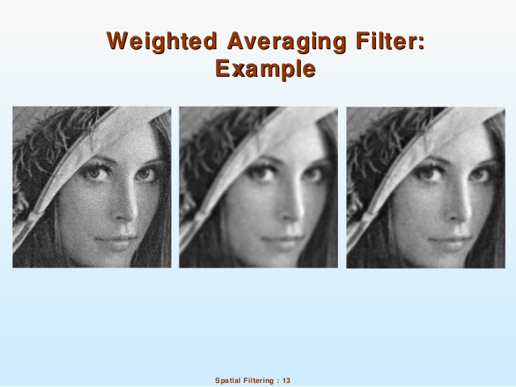

Slide 33
Non-Linear Smoothing Filters
Median filter
Based on statistics
Ascending order:
104
100
108
85
90
95
98
99
100
104
106
108
99
106
98
99
95
90
85
Original Image Pixels
Processed Image Pixels

Slide 34
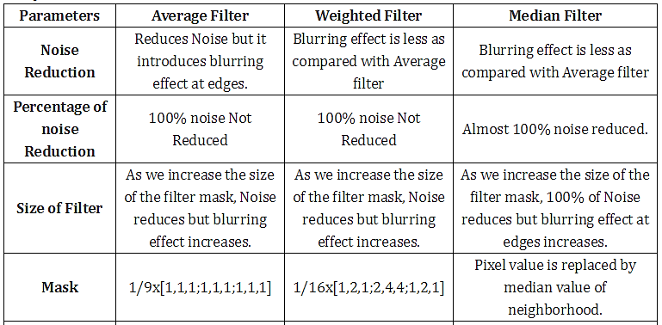

Slide 35
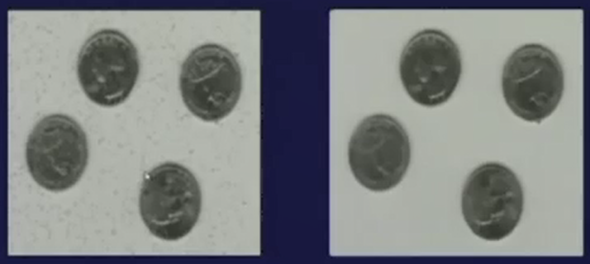
Averaging Filter Vs. Median Filter
Example
Image After Averaging Filter
3 X 3
Image After Median Filter

Slide 36
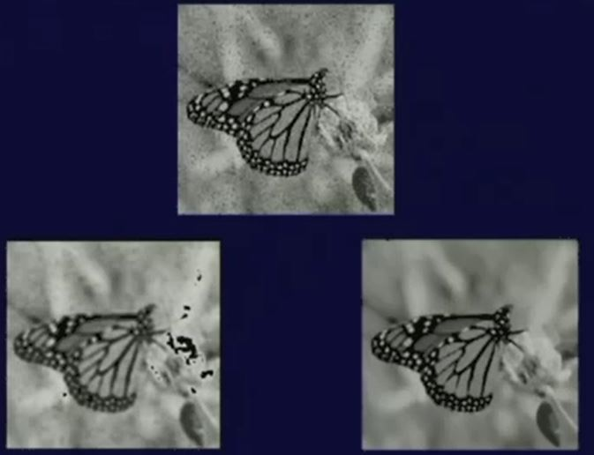
5 X 5

Slide 37
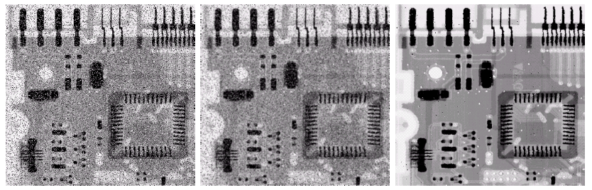
Averaging Filter Vs. Median Filter
Example
Original Image With Noise
Image After Averaging Filter
Image After Median Filter
Sharpness/ edges are blurred in averaging filter but in case of median filter, edges are less blurred.
In median filter, noise removal can be achieved with less mask size.

Slide 38
Sharpening spatial filter
The principal objective of sharpening is to highlight fine detail in an image or to enhance detail that has been blurred, either in error or as an natural effect of a particular method of image acquisition.

Slide 39
First order derivative filter
Second order derivative filter

Slide 40
First order derivative filter
The formula for the 1st order derivative of a function f(x) is :
It is the difference between subsequent pixel values and measures the rate of change of the function

Slide 41
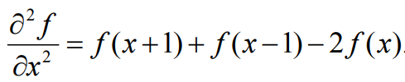
Second order derivative filter
The formula for the 2nd derivative of a function is as follows:
Simply takes into account the values both before and after the current value

Slide 42
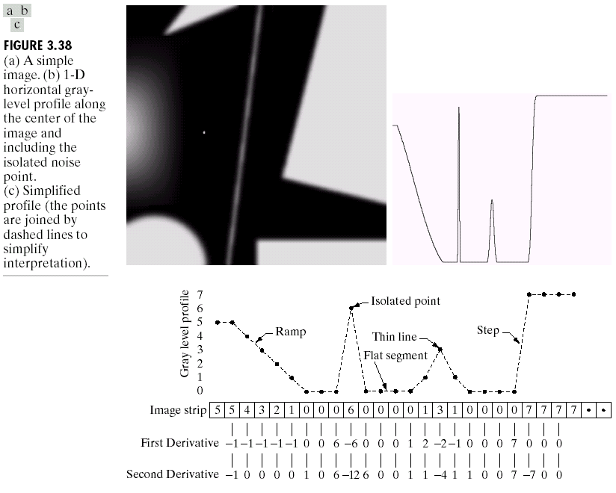
Example

Slide 43
A
B

Slide 44
Isolated point
Ramp
Step
Thin line
Flat segment
5 | 5 | 4 | 3 | 2 | 1 | 0 | 0 | 0 | 6 | 0 | 0 | 0 | 0 | 1 | 3 | 1 | 0 | 0 | 0 | 0 | 7 | 7 | 7 | 7
 | -1 | -1 | -1 | -1 | -1 | 0 | 0 | 6 | -6 | 0 | 0 | 0 | 1 | 2 | -2 | -1 | 0 | 0 | 0 | 7 | 0 | 0 | 0
0
 | -1 | 0 | 0 | 0 | 0 | 1 | 0 | 6 | -12 | 6 | 0 | 0 | 1 | 1 | -4 | 1 | 1 | 0 | 0 | 7 | -7 | 0 | 0

Slide 45
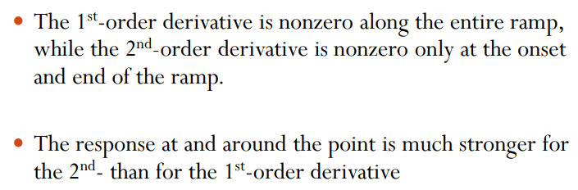

Slide 46
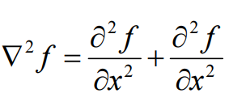
Laplacian filter (2nd order derivative)
The Laplacian is defined as follows:
where the partial 1st order derivative in the x direction is defined as follows:
and in the y direction as follows:

Slide 47
So, the Laplacian can be given as follows:
We can easily build a filter based on this
0
1
0
1
-4
1
0
1
0

Slide 48
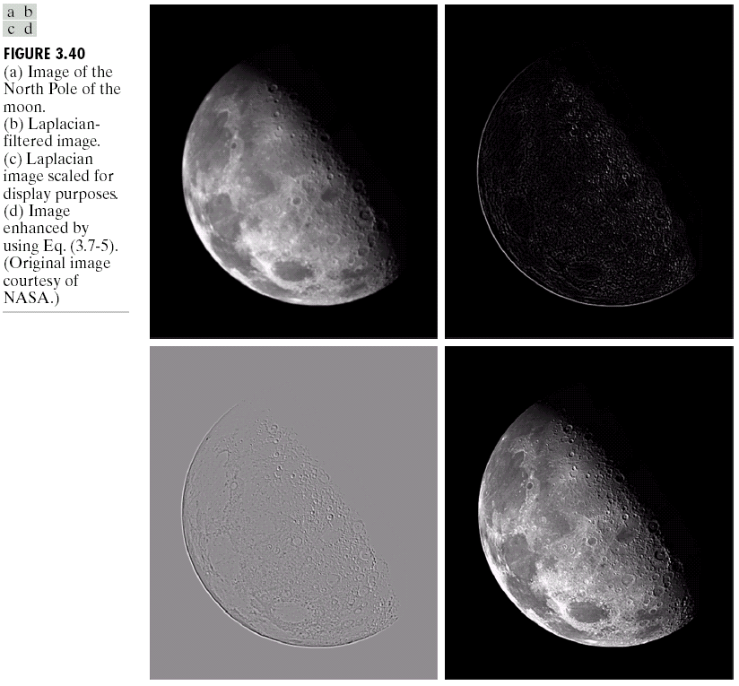
Applying the Laplacian to an image we get a new image that highlights edges and other discontinuities.
Original Image
Laplacian Filtered Image

Slide 49
Subtract the Laplacian result from the original image to generate our final sharpened enhanced image
-
=
Original Image
Laplacian Filtered Image
Sharpened Image

Slide 51
The entire enhancement can be combined into a single filtering operation
0
-1
0
-1
5
-1
0
-1
0

Slide 52




Unsharp Masking
Steps
Blur
Subtract from original image (unsharp mask)
add resulting mask to original image
$$f_{b}(x,y)$$
$$mask=f\left(x,y\right)−f_{b}(x,y)$$
$$f_{sharp}\left(x,y\right)=f\left(x,y\right)+mask$$
$$f_{sharp}\left(x,y\right)=2f\left(x,y\right)−f_{b}(x,y)$$

Slide 54
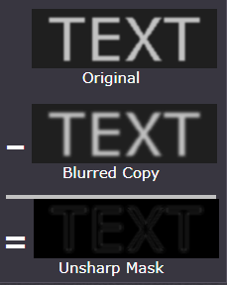
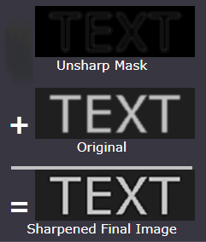

Slide 55


High boost filtering
$$f_{hb}\left(x,y\right)=\left(A+1\right)f\left(x,y\right)−f_{b}\left(x,y\right), A≥1$$
$$=\left(A−1\right)f\left(x,y\right)+2f(x,y)−f_{b}\left(x,y\right)$$
$$=\left(A−1\right)f\left(x,y\right)+f_{sharp}\left(x,y\right)$$
Laplacian
$$=Af\left(x,y\right)−f(x,y)+f_{sharp}\left(x,y\right)$$
$$=Af\left(x,y\right)−∇^{2}f(x,y)$$
What is the mask for this????

Slide 56
0
-1
0
-1
A+4
-1
0
-1
0

Slide 57
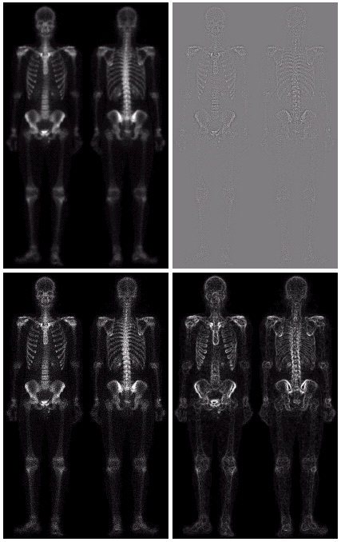
Combining Spatial Enhancement Methods
Successful image enhancement is typically not achieved using a single operation
Rather we combine a range of techniques in order to achieve a final result

Slide 58
(a)
Laplacian filter of bone scan (a)
(b)
Sharpened version of bone scan achieved by subtracting (a) and (b)
(c)
1st derivative
(d)

Slide 59
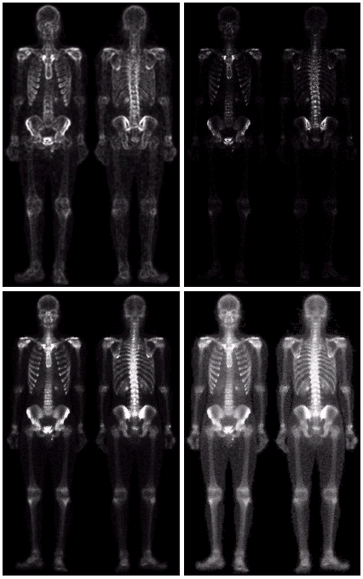
Result of applying a power-law trans. to (g)
(h)
Sharpened image which is sum of (a) and (f)
(g)
The product of (c) and (e) which will be used as a mask
(f)
(e)
Image (d) smoothed with a 5*5 averaging filter

Slide 60
Matlab task: To obtain the output image using the techniques explained in previous slides.

Slide 61
Assignment
Which is more preferred for smoothening the image - averaging filter or median filter? Explain the reason.
Explain first order derivative and second order derivative filter. Which is more preferred and why?
Why Laplacian operator is normally used for image sharpening operations?
What is unsharp masking?
How is the mask for high boost filtering achieved?

